Slide 1
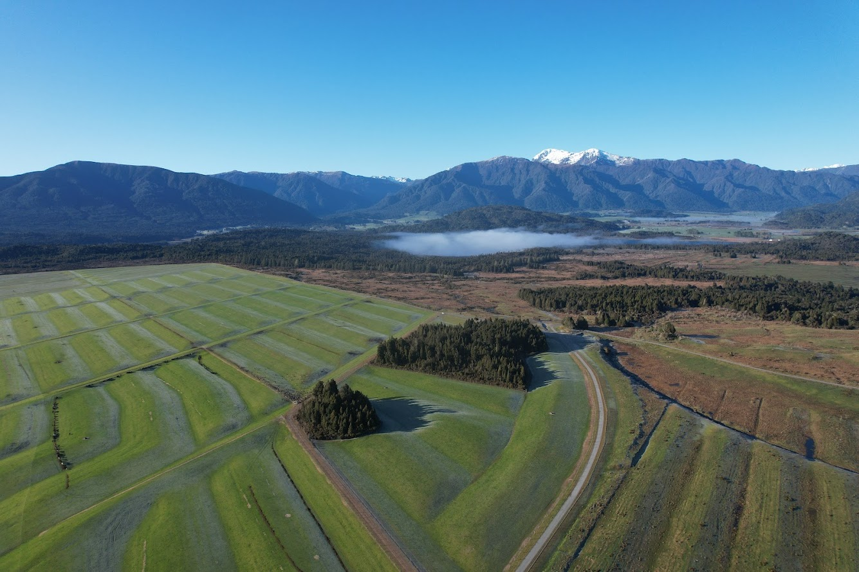


Weka Farm Open Day
Dairy Beef Integration
With thanks to
16 April 2025
Notes:
Should ideally be a photo of Weka Farm

Slide 2

Please note the following hazards:
Biosecurity
Electric Fences
Stock (unpredictable)
Machinery – please stay well clear
Trip Hazards
Zoonotic Diseases (wash hands)
Welcome to Weka - Dairy beef integration
09:45am | Guest arrival, biosecurity, sign in, coffees
10:00 am | Welcome, H&S Introduction | Cam Walker Cougan Terry
10:05 am | Pāmu context Weka and West Coast LUC Dairy beef challenges and opportunities | Mark Leslie Cam Walker
Your health and safety is important.
Hi-Viz should be worn and sign in / out
Please help us keep farms free of pests, weeds, and disease, with clean footwear (foot baths at entrance)
Add sponsor logos
10:40am Split for three rotations OF 35 minutes each 10:40 - 11:15 - 11:50
Location | Topic | Speaker
1 | Genetics, LIC | Paul Charteris
2 | Calf rearing at scale | Karen Fraser and Kim Hooper
3 | Forage & feed Processing and markets | Cougan Terry, Dan Mears, Mark Burnside
12:25pm | Reconvene
 | Wrap up and Q&A | Cam Walker
12:35pm | Lunch With thanks to Silver Fern Farms
1:20pm | Close

Slide 3
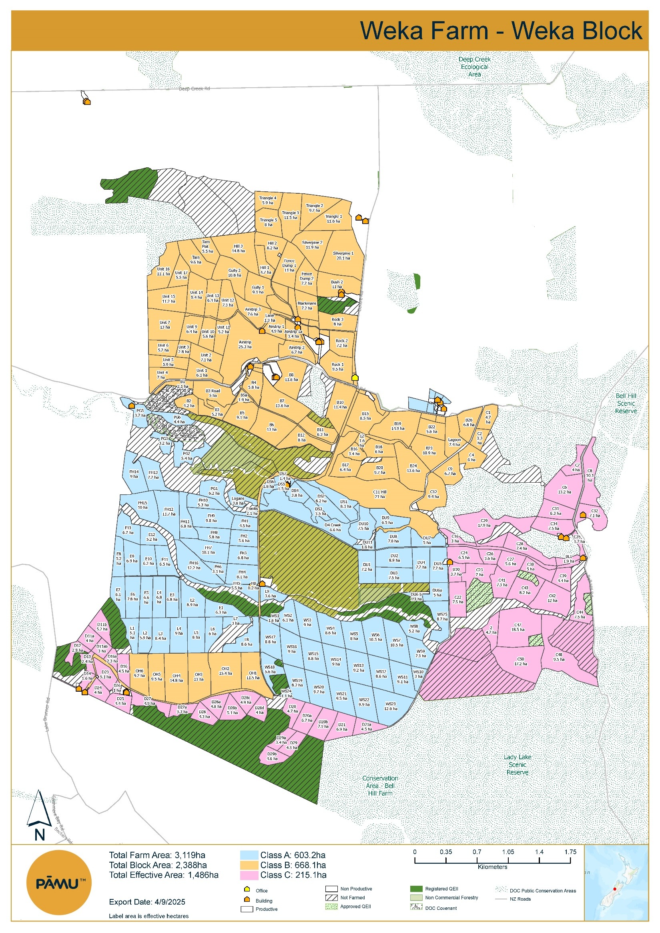
Area
Total Hectares = 3,119ha
Effective Hectares = 1,670ha
    A Class – 609ha
    B Class – 709ha
    C Class – 352ha
Stock Mix
250 MA Angus Breeding Cows
+ Finish All Progeny
  230 R1s (Incl. Heifers
  and Bulls)
    230 R2s (Incl. Heifers
    and Bulls)
12 MA Angus Sire Bulls
1,454 Dairy Beef
    227 R2 Heifers
    496 R2 Bulls
    422 R1 Heifers
    309 R1 Bulls
  800 Grazing Dairy Heifers
    400 R1 Heifers
    400 R2 Heifers
Personnel
Permanent Staff
    X1 Farm Manager
    X1 Stock Manager
    X1 Shepherd General
  Seasonal Staff ~X6 Calf Rearers
Dairy Beef Stock Policy
Rearing 1,400 Dairy Beef Calves (From ~7 days to 100kgsLWT)
Finish 800 Dairy Beef Heifers/ Bulls
Sell 120 @ 100kgsLWT to Brunner Farm for Finishing
480 to @ 100kgsLWT to Cape Foulwind Farm for Finishing
Calf Rearing Capacity
  Dairy Beef Shed (DBS) 1 & DBS 2
    18 Pens Per Shed
    20 Calves Per Pen
    360 Calves Per Shed / Per Rotation
    2 Full Rotation Per Shed Per Season (Aug – Nov)

Slide 4
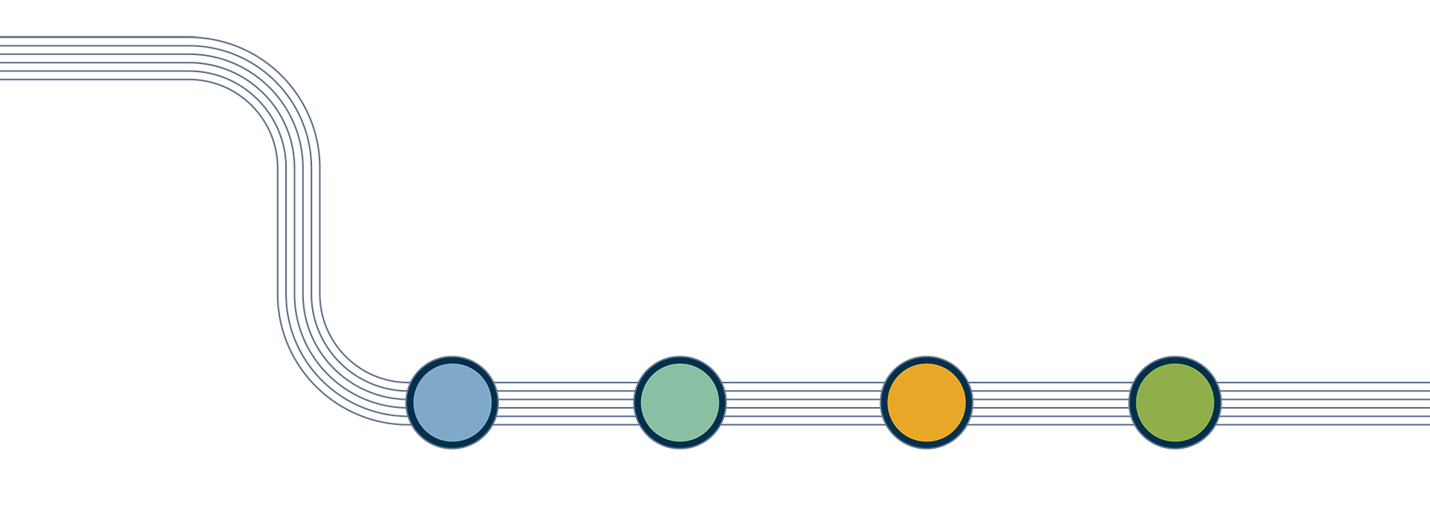




Our Strategy to 2040
OUR VISION
Cultivating a Bold Tomorrow, Together.
OUR Whakataukī
He mauri tō te wai, He mauri tō te whenua, He mauri tō te tangata
We acknowledge the life force and essence of the water, the land and the people.
OUR PURPOSE
To lead the delivery of innovative and sustainable agriculture solutions for future generations.
OUR STRATEGIC CHOICES
DELIVER
OPERATIONAL EXCELLENCE
GROW
PEOPLE IN A SAFE ENVIRONMENT
CHANGE
LAND USE WITH INTEGRATED
FARMING SYSTEMS
INNOVATE
& PARTNER TO
MEET MARKET OPPORTUNITIES
ENRICH
THE NATURAL WORLD
OUR VALUES
Shoulder-to-shoulder
Bold
Genuine
Grounded
OUR OUTCOMES
Culture of excellence
Sustainable commercial performance
Trusted partner
Thriving natural world

Slide 5
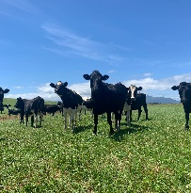
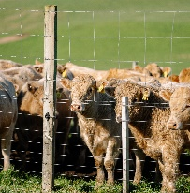
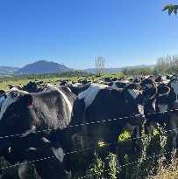
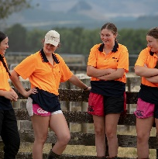
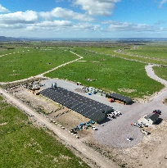
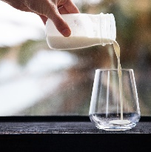
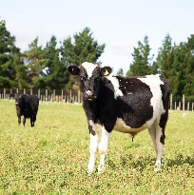
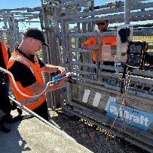
Pāmu dairy beef strategy
Goal: Utilise 100% of non-replacement dairy calves
Heifer mating
Genetics
Dairy units
People
Calf rearing facilities
Processor partnerships
Dairy beef finishing
Technology
West Coast Integrated Farm System

Slide 6
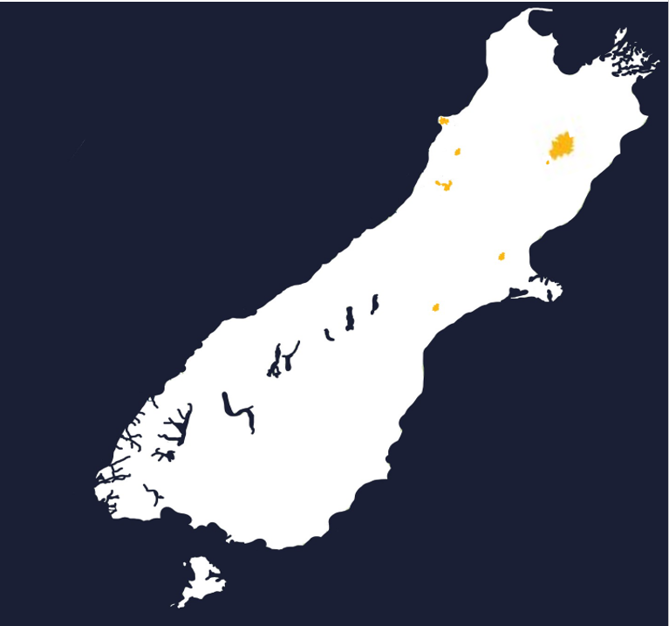
Pāmu Farms – Upper South Island
115 Permanent Staff
  40 Seasonal Staff
26 Business Units
  15 Dairy Farms
  9 Livestock Farms
  2 Machinery Syndicates
5.1 Million Milk Solids
  8 Farms Supplying A2 Milk
199,800 Stock Units
  14,200 Dairy Cows Wintered
  7,150 Dairy Young Stock
  6,000 Beef Breeding Cows (Incl. Replacements)
  8,000 Dairy Beef/ Trade Cattle
16,950 Total Hectares (Excl. 181,200Ha @ Molesworth)
  12,900 Effective Hectares
CAPE FOULWIND
BASSETS, TOTARA, TRAM ROAD DAIRY UNITS, WEST COAST DAIRY SUPPORT, CAPE FOULWIND FARM, CAPE FOULWIND MACHINERY
GREY VALLEY
THOMPSONS, SOMERVILLES DAIRY UNITS, AHAURA FARM, BURKES CREEK DAIRY SUPPORT
WEKA
BLAIRS, KOTUKU, BELL HILL, RURU, SOUTERS DAIRY UNITS, BRUNNER DAIRY SUPPORT, WEKA FARM, WEKA MACHINERY
Canterbury
Livestock
MOLESWORTH STATION & HANMER FARM
Canterbury
Dairy
MARONAN, MAYFIELD, VALETTA, WAIMAKARIRI, EYREWELL DARY UNITS, ROSEBANK DAIRY SUPPORT
West Coast Integrated Farm System

Slide 7
Pāmu Farms – Upper South Island
“Pāmu is aiming to rear all calves from its dairy herds for meat and milk production by 2030”
In 2021 we established a plan to integrate our dairy and livestock businesses on the West Coast, creating a closed system that, at present, absorbs 65% of our dairy calf crop.
2021
2022
2023-25
2026-29
2030
Our focus: Farming excellence and innovation
60.7% Dairy Cows 17.1% Deer 14.9% Dairy Youngstock 4.4% Beef Breeding Cattle 1.8% Sheep 1.1% Dairy Beef | Develop a reduced bobby calf system through dairy and livestock integration, reducing the need to carry deer and beef breeding herds. Increased dairy beef production will generate improved protein conversion efficiency, and GHG intensity in comparison to traditional livestock breeding system. | Understand biosecurity and agronomic risks associated with planned system changes. Expansion of rearing capacity through the conversion of woolsheds at Cape Foulwind and Weka. 25% of dairy herds mated to beef. | Adopt genetic improvements and various technological advancements on dairy herds to support the full utilisation of the dairy calf crop. Farming excellence and enhance biosecurity at a large scale through a closed farm system. The ability to be fully self-contained. Optimise feed conversion efficiency, through the utilisation of various stock classes. System 2 dairy business, >90% of feed is grown on farm. | 56.9% Dairy Cows 25.2% Dairy Beef 13.5% Dairy Youngstock 4.4% Beef Breeding Cattle
West Coast Integrated Farm System

Slide 8
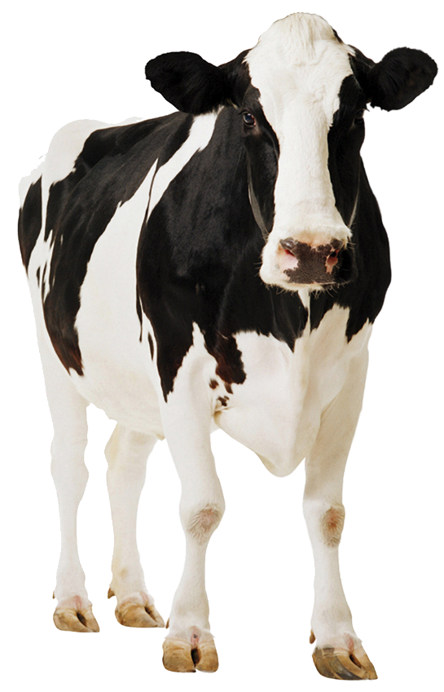
Mating Plan
Top 5% BW to Sexed Semen (Selected from top 25% BW)
Mid 70% BW to Bull of the Day (AI)
Bottom 25% BW to Beef (AI or Naturally Mated)
R2s
Weeks
1 - 6
Weeks
7 - 10
Weeks
11 - 12
Double PG Artificial Insemination | Artificial Insemination (Bottom 25% BW to Beef) | Naturally Mated (Beef) | Short Gestation Artificial Insemination (Dairy)
West Coast Integrated Farm System

Slide 9
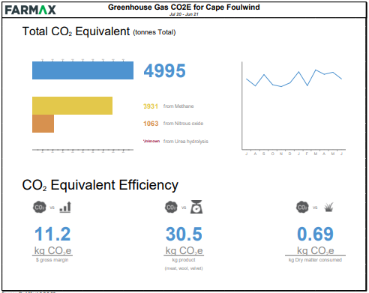
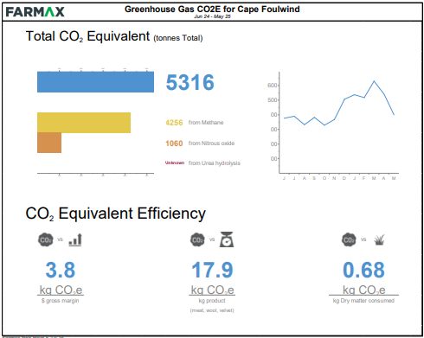

Opportunities
Significant improvement in GHG Intensity per kilogram of product
A recent AgResearch lifecycle assessment of dairy-beef systems found that:
  Dairy-beef is 22% more efficient than traditional beef systems
  Fast-finishing prime dairy-beef systems can achieve 38% to 42% reductions in GHG intensity, thanks to a statistically significant relationship between GHG intensity, cattle age, and growth rate (efficient systems are a significant driver - managing feed efficiency and finishing time in tandem is key).
Increased kilograms of product produced per hectare
Social licence to farm – absorbing dairy calf crop
Improved overall Herd Quality/Performance through breeding from highest Genetic Merit Cows
Increased pasture production through improved rotational grazing policies
Reduced capital requirement for waterway fencing (FWFP).
Challenges
Calf Rearing Infrastructure Requirements
Biosecurity
  Calf disease risk from multiple farms
Increased Complexity on farm
  Mating Plans
  More mobs at calving/mating
  Marker bulls
  Identifying Beef Calves at Birth
  Rearing Capacity on Farm
Works space
Fast finish model on marginal ground.
GHG Modelling – Old System
GHG Modelling – New System

Slide 10
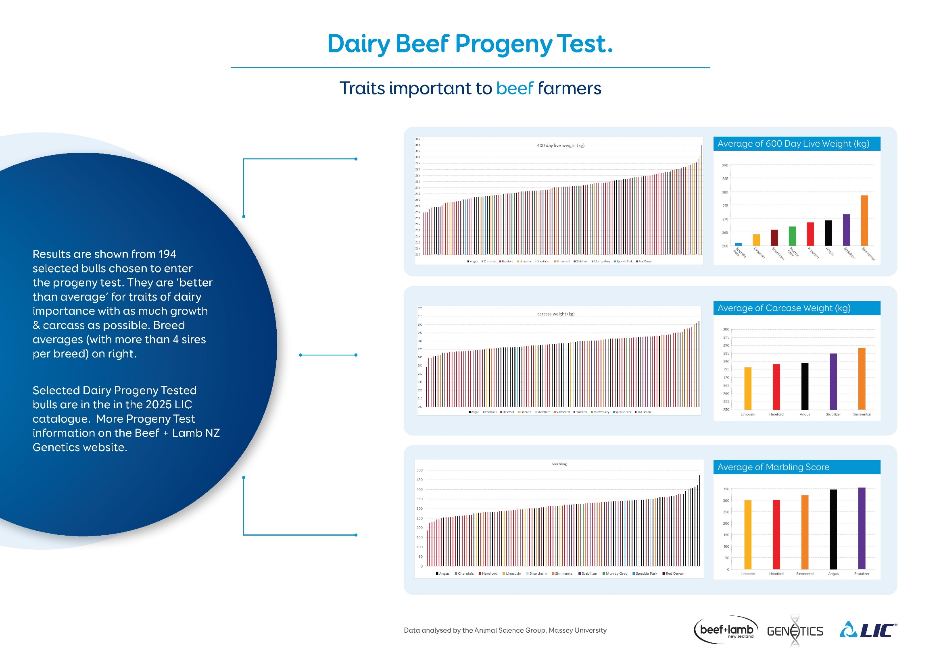

Slide 11
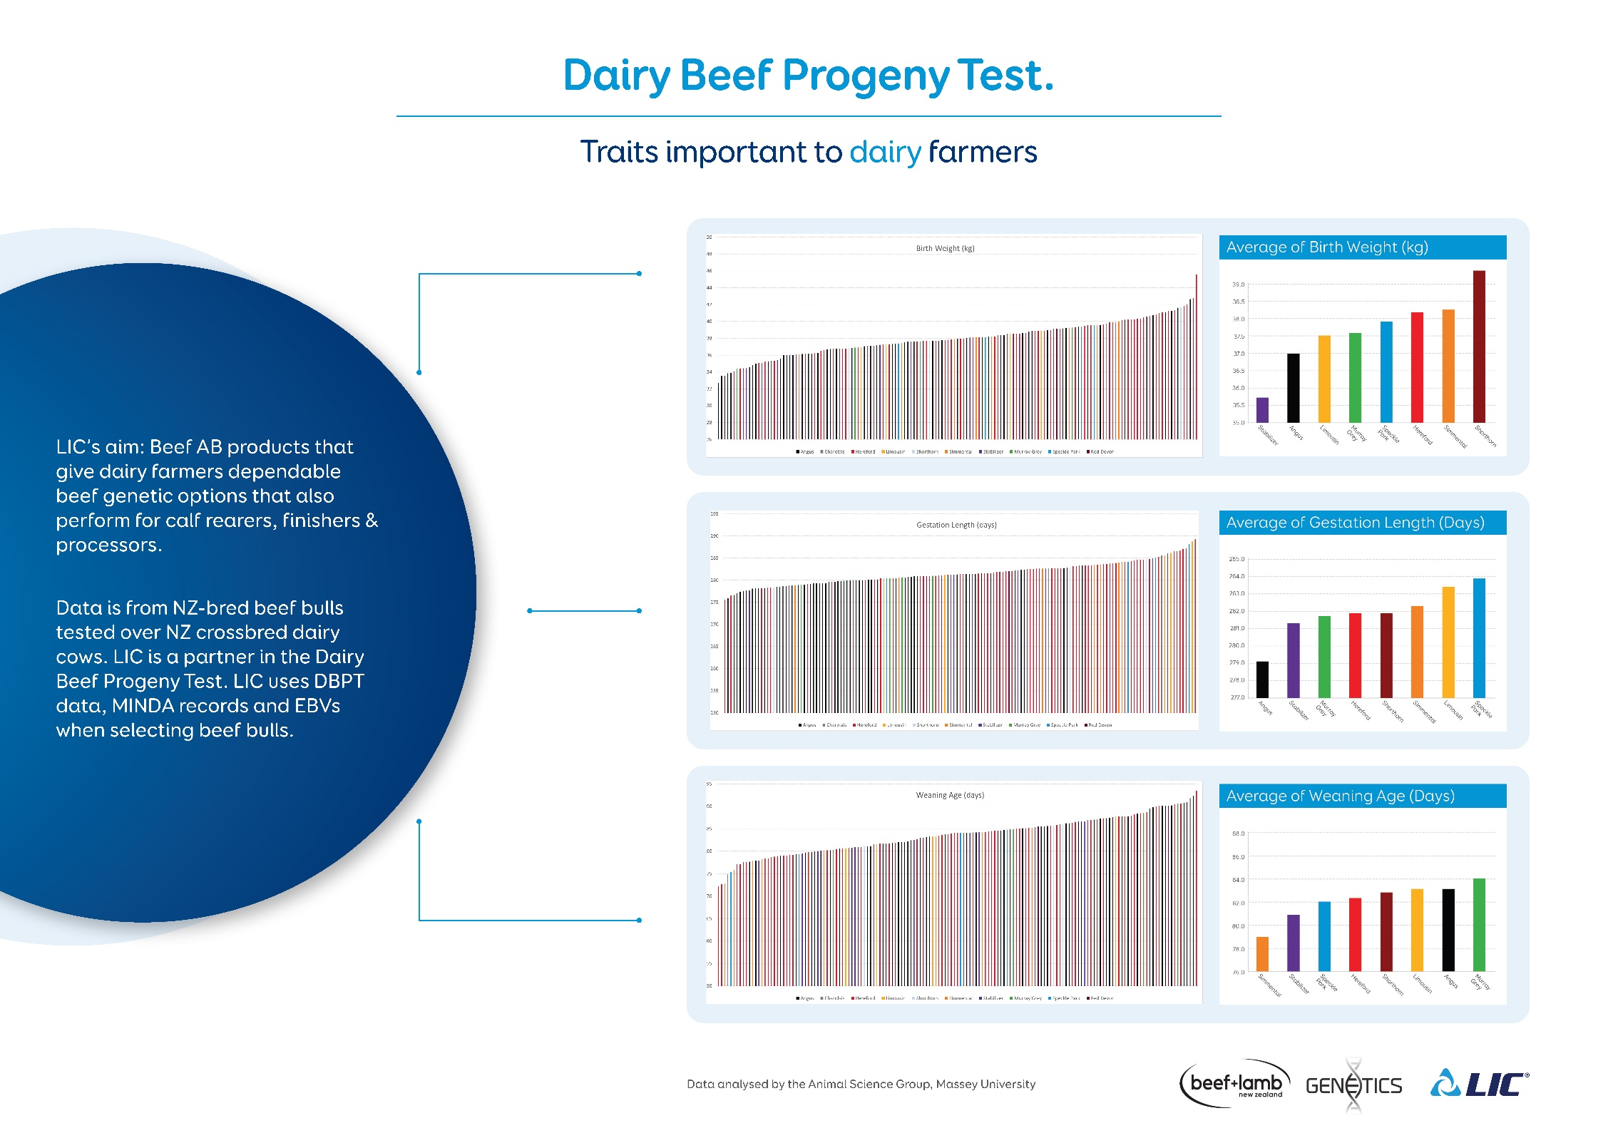

Slide 12
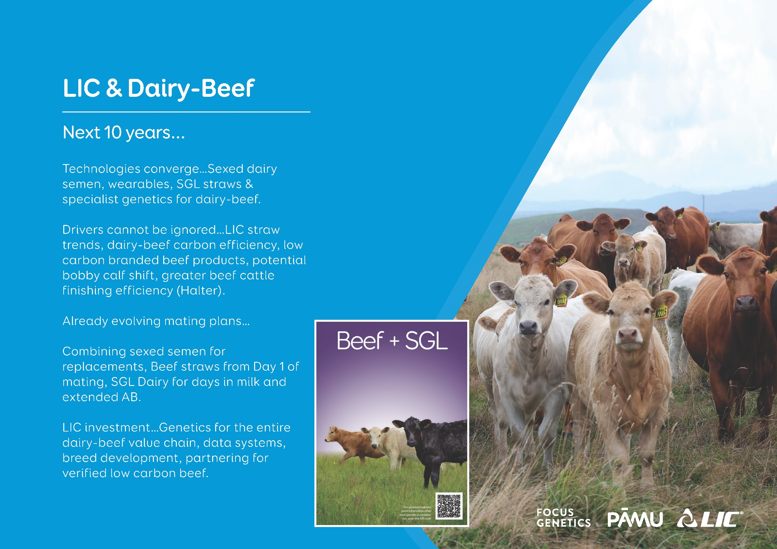

Slide 13
Calf rearing at scale
Challenges
Cow Condition and Mineral Status Pre-Partum: Ensuring cows are in optimal condition and have the necessary minerals before calving.
Calf Handling and Colostrum Day 1 Process: Proper handling of calves and ensuring they receive colostrum on the first day (5Q’s of colostrum).
Bacteria Loading in First 4 Days of Life: Maintaining hygiene to reduce bacterial exposure.
Transitioning: Whole milk to CMR challenges
Relocation and Environmental Stressors: Managing stress and inflammation during relocation.
Infrastructure: Dealing with condensed calving periods and the need for adequate facilities.
Hygiene and Biosecurity Risks: Protecting both calves and people from zoonotic diseases.
Retaining Good Staff: Building passion and retaining skilled staff in the industry.
Solutions
Team Development: Providing training and support visits to offer fresh perspectives and improve skills.
Infrastructure Changes: Utilising or modifying existing sheds to better suit current needs.
Evolving Programs and Nutrition: Adapting programs and nutrition plans to meet Westcoast challenges.
Proactive Animal Husbandry: Developing teams with strong animal husbandry skills for a proactive approach.
Encouraging Lifelong Learning: Promoting continuous learning among team members.
Enhanced Biosecurity: Strengthening biosecurity measures with a focus on hygiene.
West Coast Integrated Farm System

Slide 14


Notes:
Add calf guides, 5x colostrum a day, .. Beef units can only survive if transition cw done well and colostrum

Slide 15
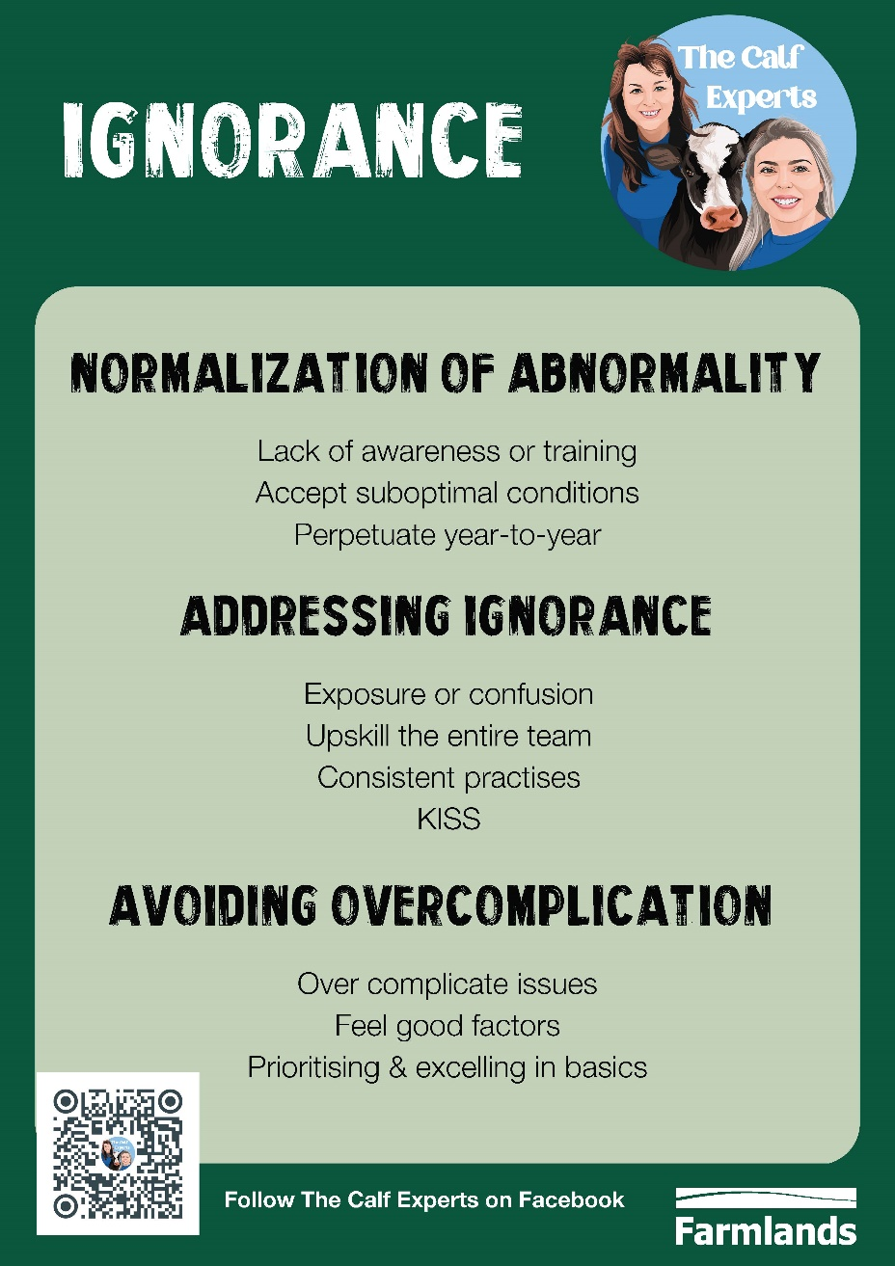
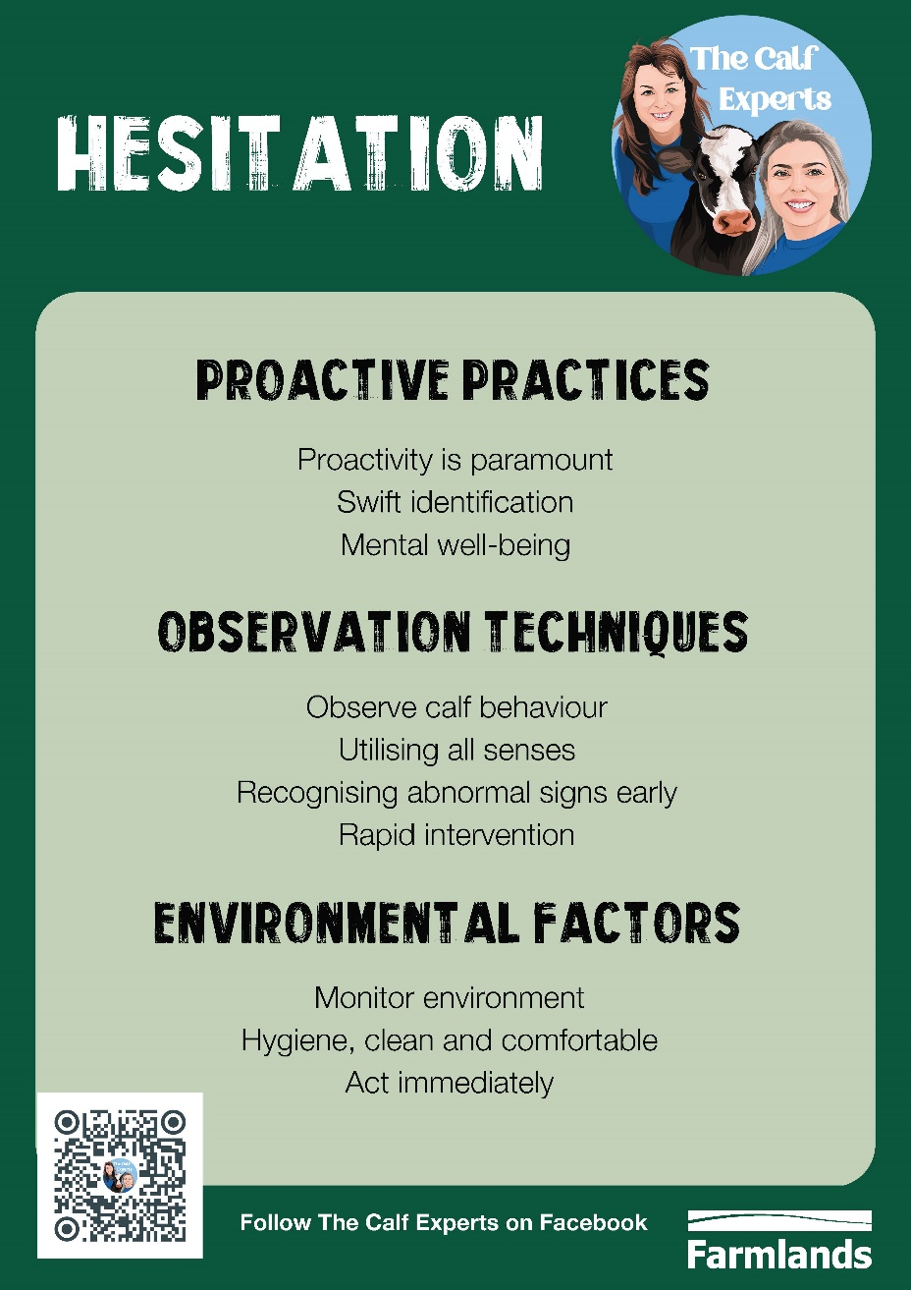
Notes:
Add calf guides, 5x colostrum a day, .. Beef units can only survive if transition cw done well and colostrum

Slide 16
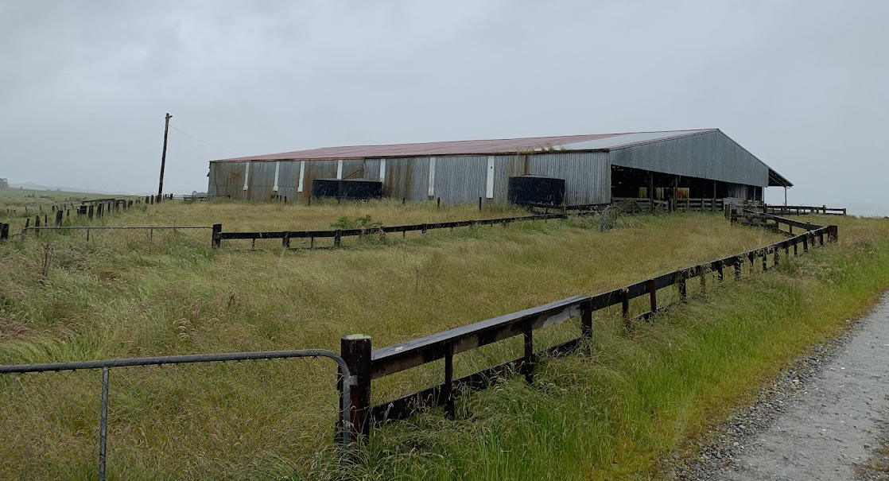
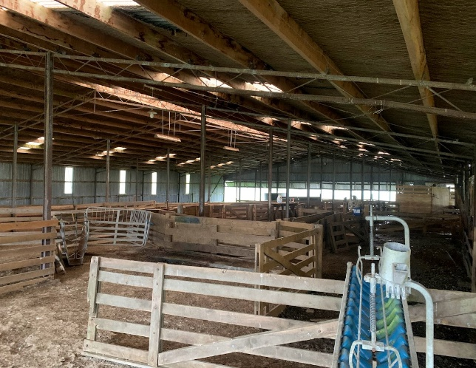
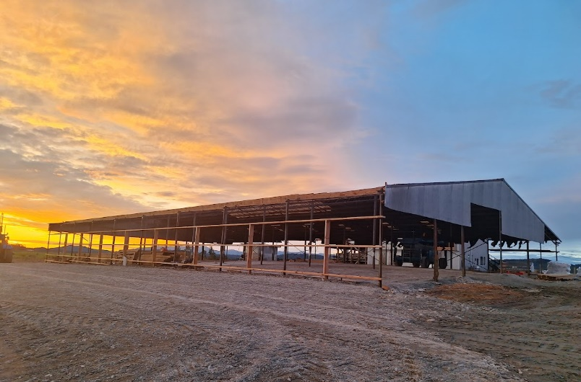
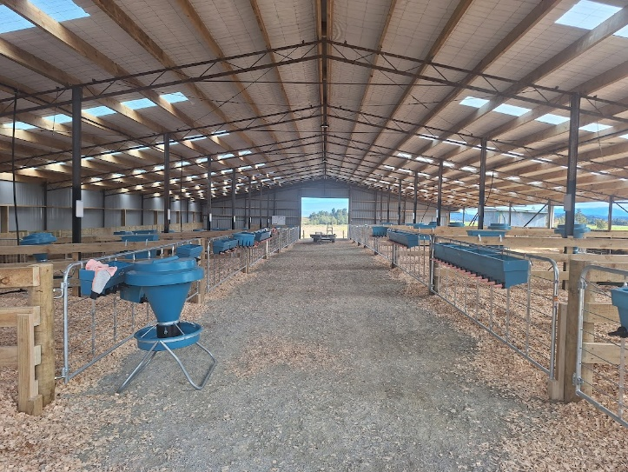
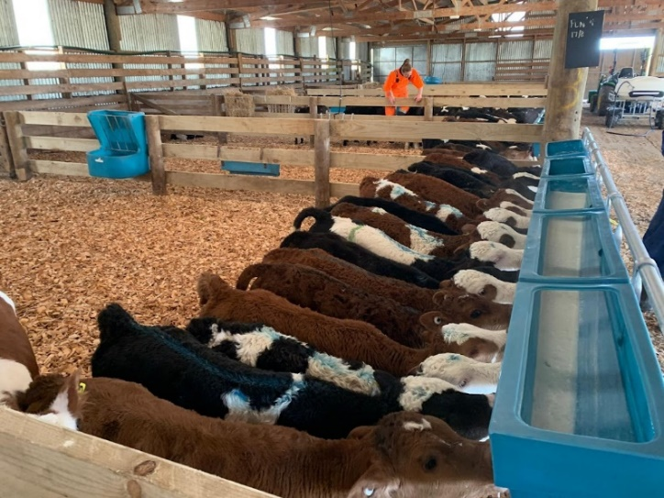
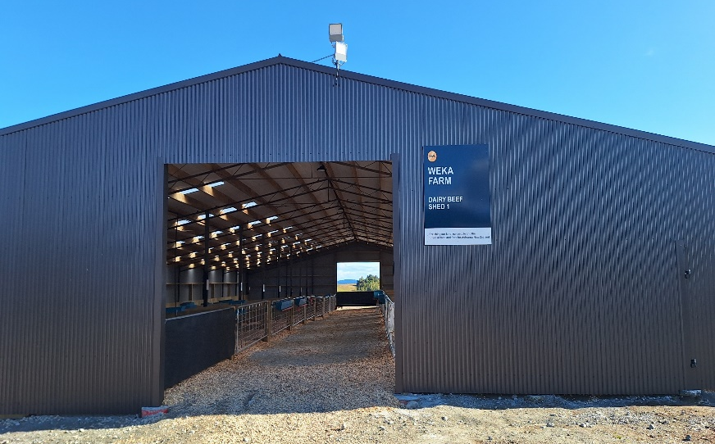
Repurposing old woolsheds / covered yards (DBS1)

Slide 17
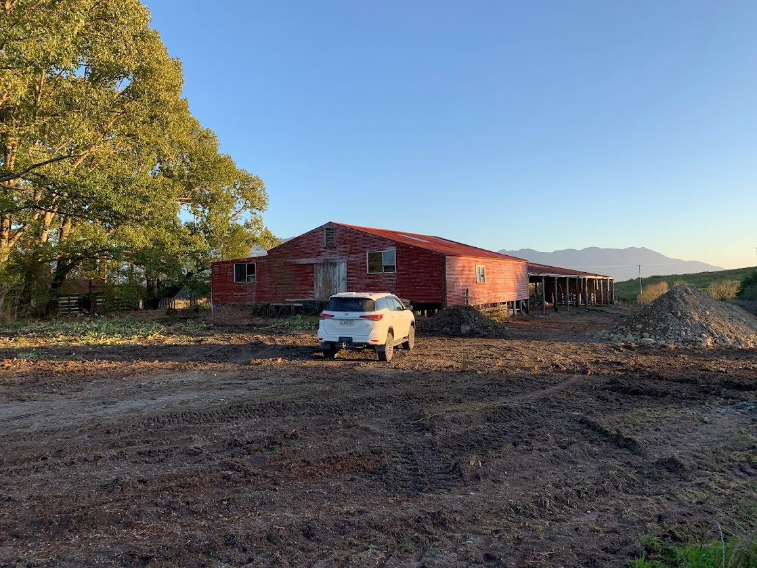
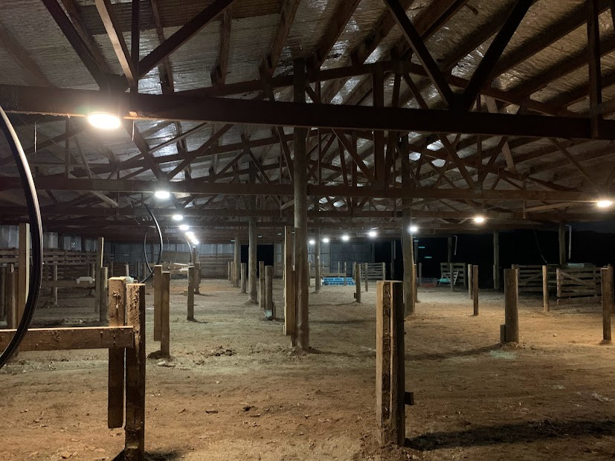
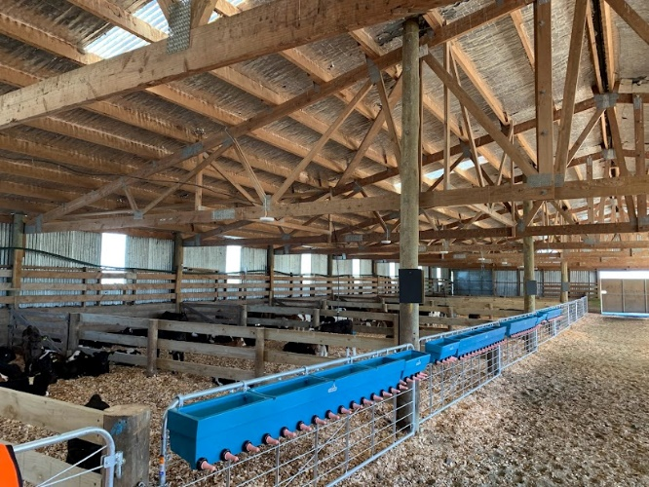
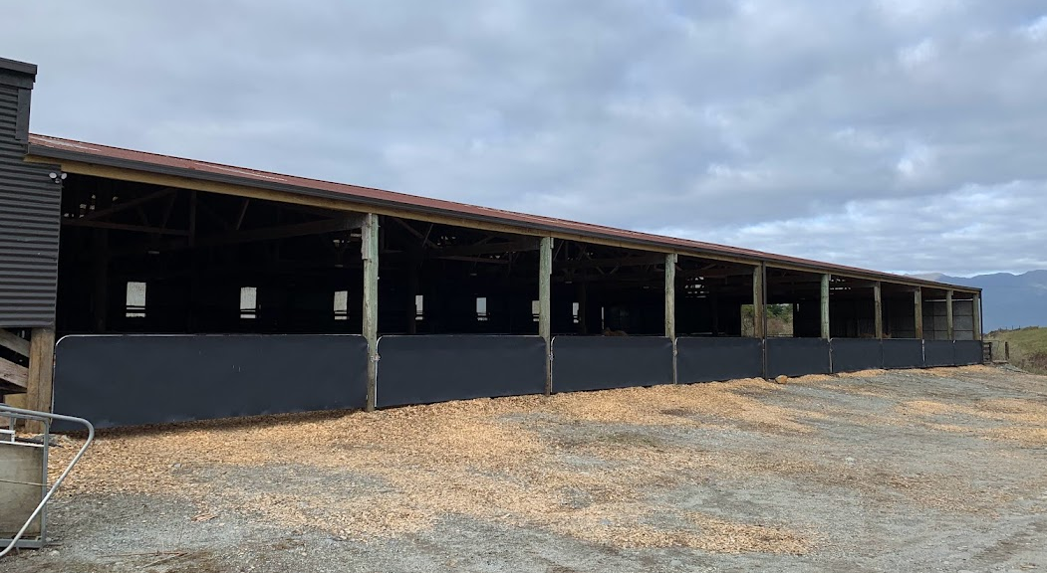
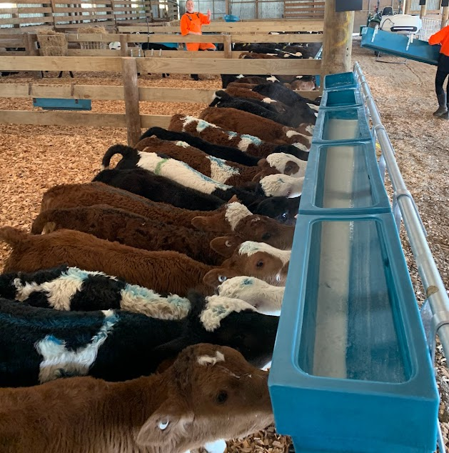
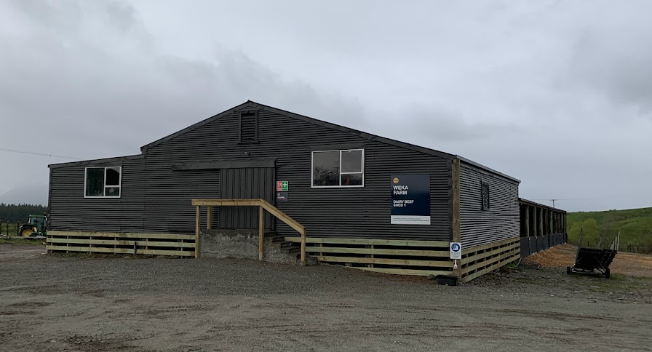
Repurposing old woolsheds / covered yards (DBS2)
West Coast Integrated Farm System
17

Slide 18
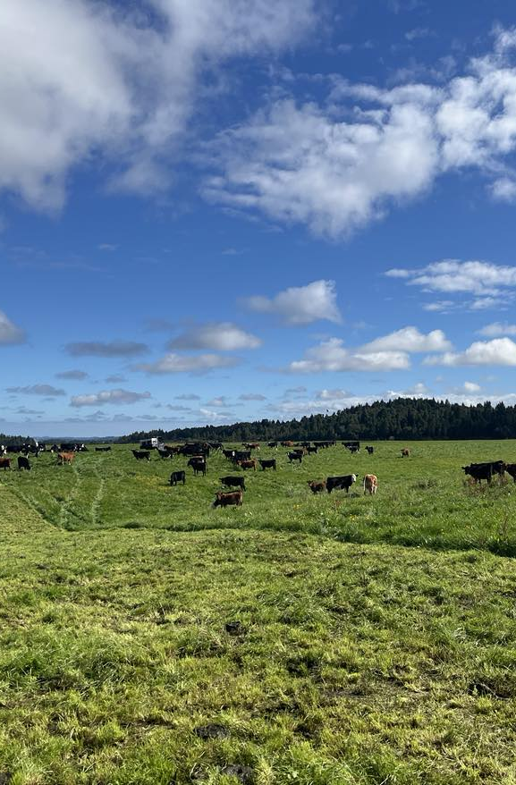
100kgs to Finishing
Focus Areas
Weaning upon weights not age (start weaning >75kgs, 95 off meal ~30 days later)
Regular monitoring of weights, attention to detail, drafting mobs into weight lines
Rotationally graze behind a break feed from 100kgs/ fully weaned – minimum 2 day breaks
Animal Health plans / active management - parasites, immunity, trace elements
Animal welfare needs – shade, shelter, handling
Nutritional requirements
  High ME feed - All pasture based up to 450kgs then winter on swedes + silage
  Agronomy - Annual regrassing program (8-10% Class A) to ensure high quality pastures
  High energy supplements
  Potable water

Slide 19
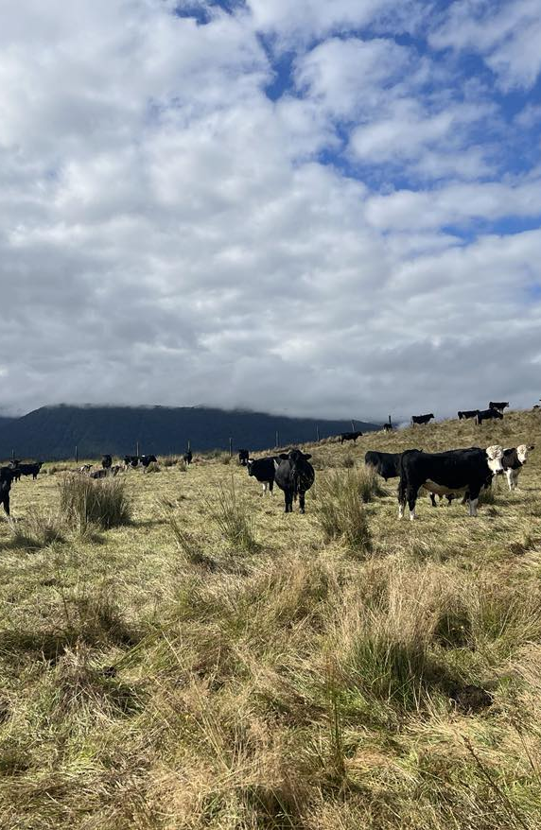
100kgs to Finishing
Targets
200kgs by 1st June (1st Winter)
450kgs by 1st June (2nd Winter)
550kg LWT Bulls to Finish >270kgCW by ~24-26 months old (>49% Yield)
500kg LWT Heifers to Finish in the Reserve Program >240kgCW by ~24-26 months old (>49% Yield)
Challenges
Utilisation across all land classes
Infrastructure – power, water, yards
Biosecurity - calf rearing
Immunocompromising – calf rearing challenges/ disease burden continue to rear its head over their life span
Wastage
Return ($)
    >270kg CW Bulls
    >240kg CW Heifers (Reserve Program)
Markets

Slide 20
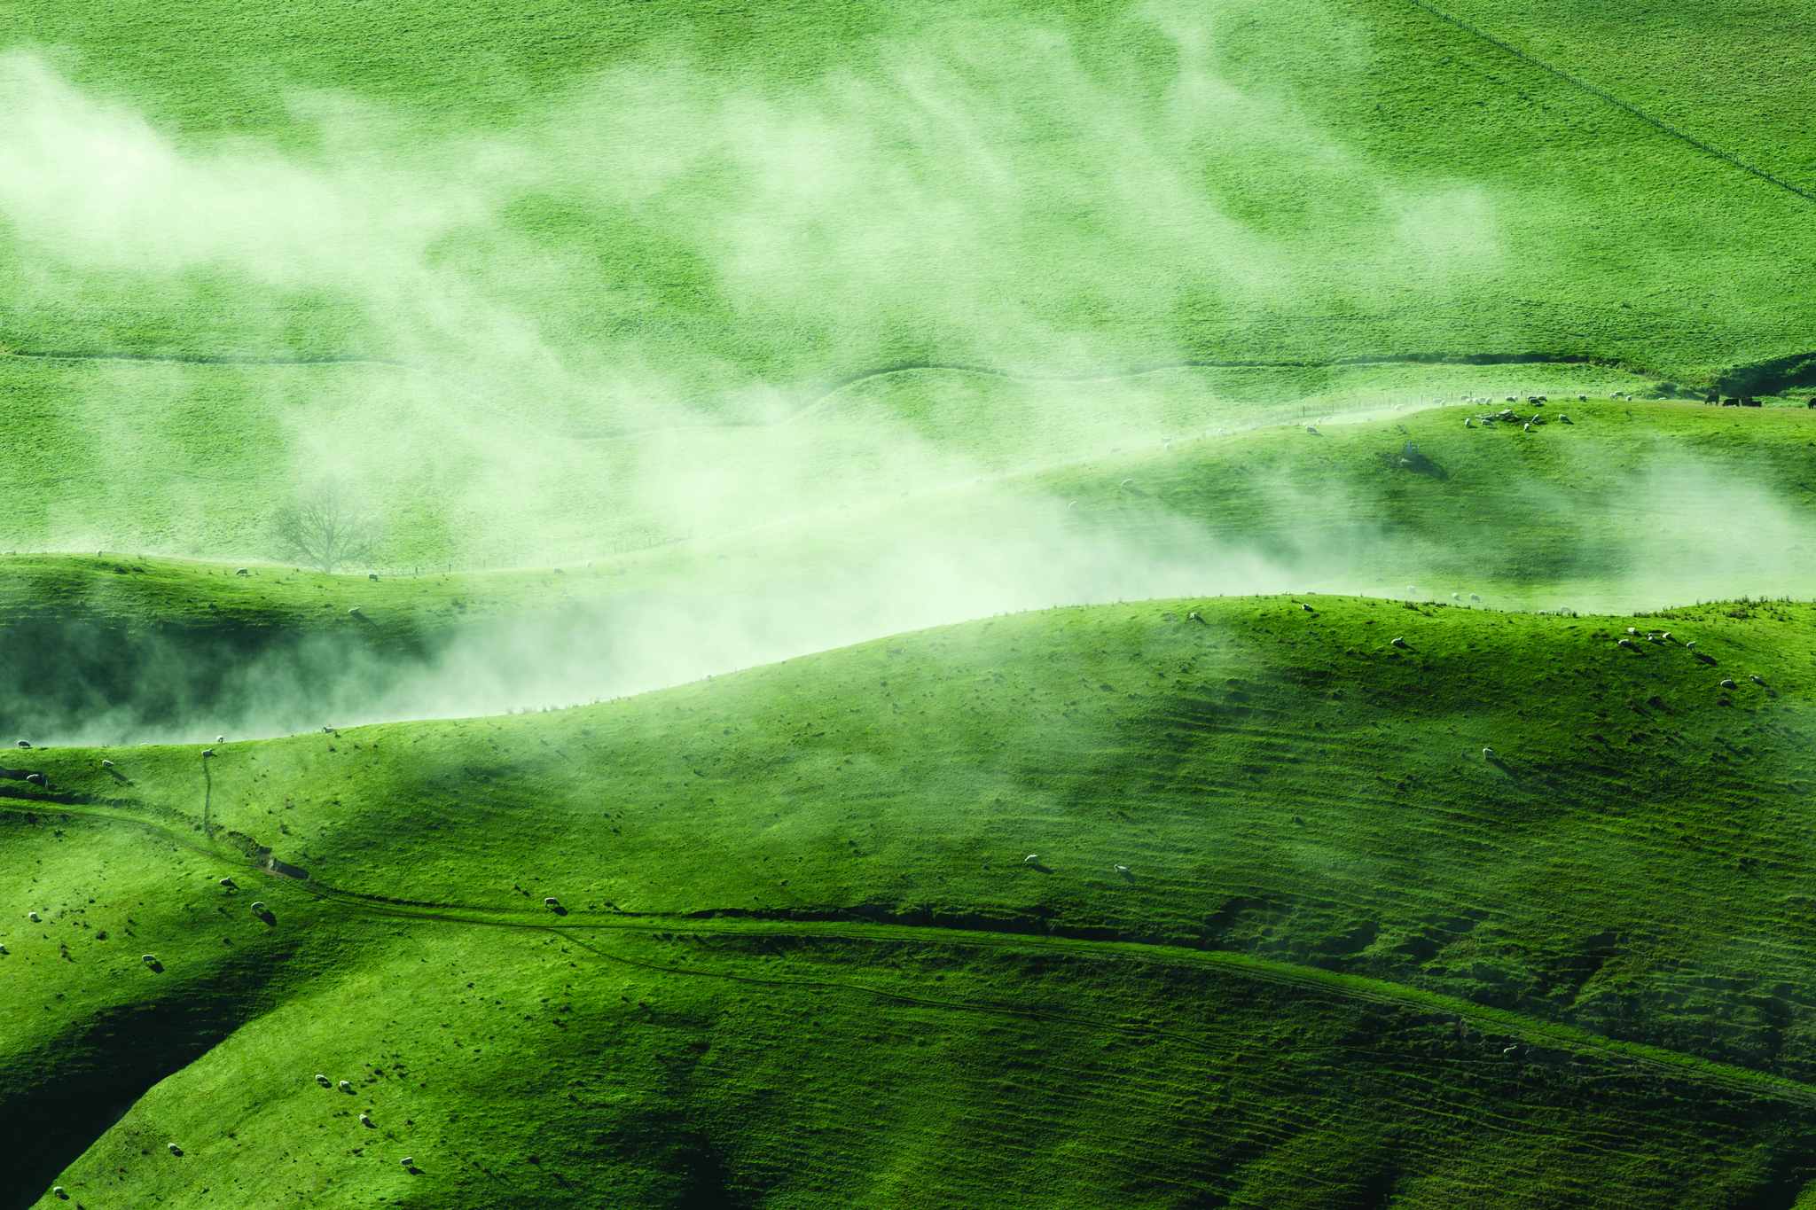
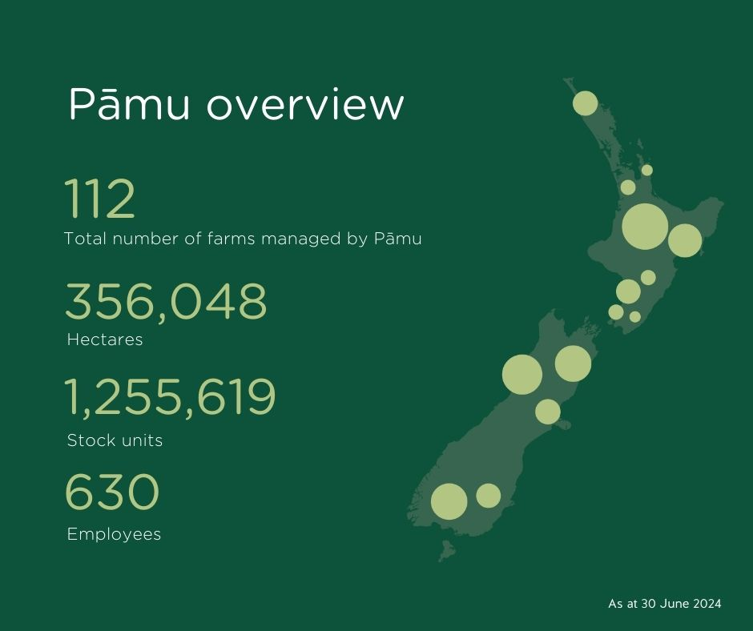
*
*
20
*Excluding Molesworth Station, (180,787ha leased from DOC), Pāmu manages 175,261ha

